Slide 1
TEAM MEMBERS
Oluwaseyi Ajoni
Awenitiye Iyalla
Ishan Shetty
Ruusa Megameno Nangolo
Joshika Malai Magal
WE ARE….

Slide 2





Slide 3


Slide 4
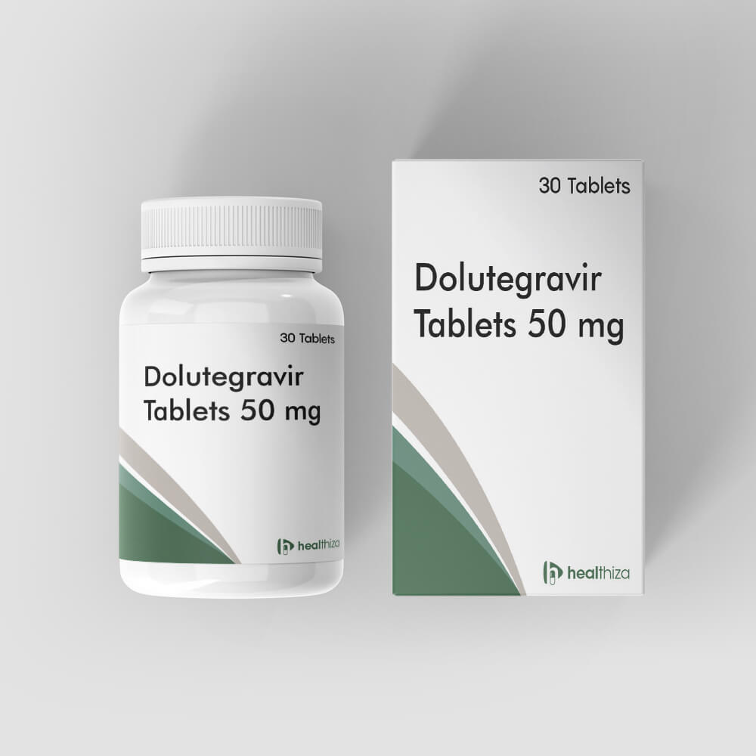
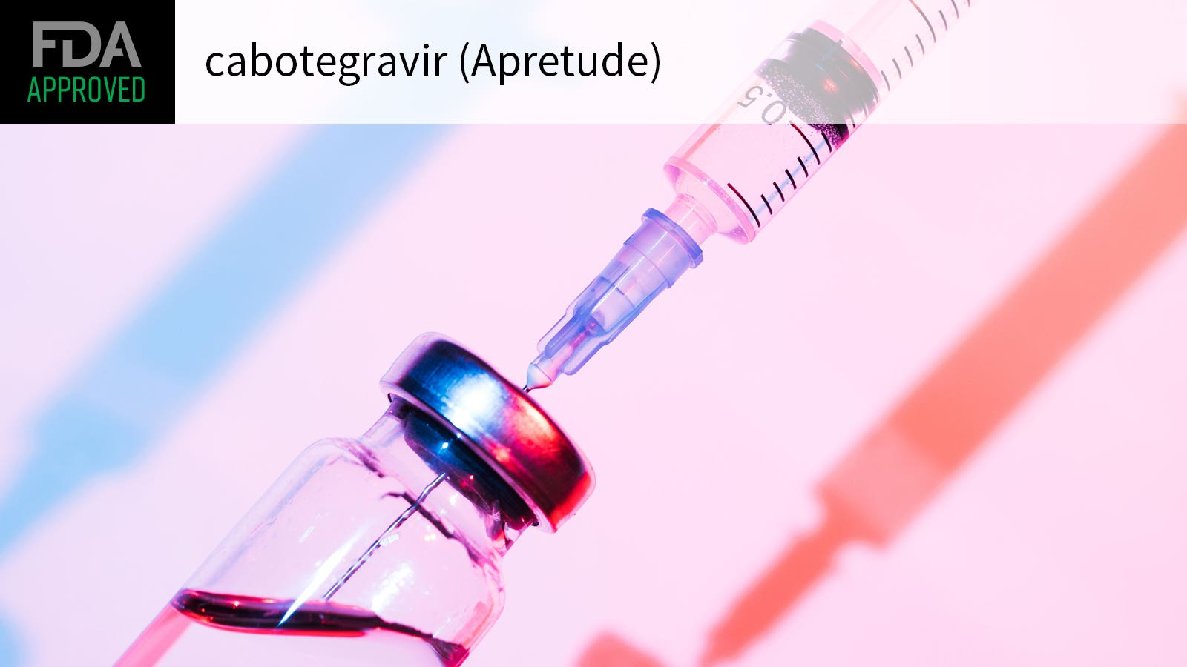
ViiV Healthcare’s Key Drugs
KEY PRODUCTS

Slide 5



Japan-based
Founded in 1878
Focus: Infectious diseases
Mission: Protect health & welfare
Leader in anti-infective research
Emphasis on antimicrobial resistance
10% shareholding
UK-based
Founded in 2000
Focus: Vaccines & global health
Mission: Unite science and talent
Known for respiratory treatments
Strong presence in consumer healthcare
76.5% shareholding
US-based
Founded in 1849
Focus: Breakthrough medicines
Mission: Change patients’ lives
Founder of COVID-19 Vaccine
13.5% shareholding
Notes:
ViiV Healthcare is a global specialist HIV company established in November 2009 by GlaxoSmithKline (LSE: GSK) and Pfizer (NYSE: PFE) dedicated to delivering advances in treatment and care for people living with HIV and for people who are at risk of becoming infected with HIV. Shionogi joined in October 2012.

Slide 6
Justification for the Joint Venture
• Combined expertise and resources
Shared risk and long-term sustainability
Focus on HIV prevention, diagnosis and treatment
Addresses market challenges
Innovation in HIV care

Slide 7
Strengths and Weakness
of ViiV Healthcare
Strengths | Weaknesses
Addresses current treatment gap for pediatric HIV care | Reduced Brand Recognition
Shared operational & financial reward | Reduced Funding for HIV Projects
Aligned mission uniting employees worldwide | Conflict of Interest
Integrated expertise | Legal, Patent and Intellectual Property Issues
Broader access to affordable HIV treatments for patients globally | Profit Sharing
Partnerships with non-profit organisations, governments and advocacy groups | Stakeholder Buy-in

Slide 8
Key Takeaways
•Established in 2009 as a JV between GSK and Pfizer with Shionogi joining in 2012.
•The company focuses solely on the research and development of HIV medication.
•Innovative product portfolio.
•Community-centered approach.
•Strategic partnerships for global reach.
•Reduced Funding for HIV Projects.

Slide 9
References
UNAIDS Global HIV & AIDS Statistics – 2020 Fact Sheet. Available from: https://www.unaids.org/sites/default/files/media_asset/UNA IDS_FactSheet_en.pdf. last accessed: 27th January 2024
Shionogi and ViiV Healthcare Press Release. Available from: https://www.shionogi.com/content/dam/shionogi/seu/news/pdf/2012/29102012.pdf. Last accessed: 27th January 2024
viivhealthcare.com. (n.d.). About Us. [online] Available at: https://viivhealthcare.com/about-viiv/ [Accessed 27 Jan. 2025].

